Slide 1
Computer Security
COMP6824001
Computer Security Principles
Session 1

Slide 2
These slides have been adapted from:
Panek, Crystal. (2019). Security Fundamental, John Wiley & Sons, Inc. Indianapolis. ISBN: 978-1-119-65066-9
Lesson 1
Acknowledgement

Slide 3
Learning Objectives
LO 1: To explain the security principles, threats, attacks and security strategy

Slide 4
CIA
(Confidentiality, Integrity and Availability)

Slide 5
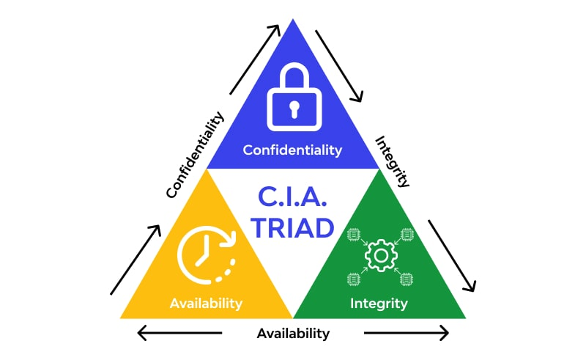
CIA Triad Illustration

Slide 6
Confidentiality
Confidentiality deals with keeping information, networks, and systems secure from unauthorized access
Confidentiality is a concept we deal with frequently in real life. The examples are :
We expect our doctor to keep our medical records confi dential.
We trust our friends to keep our secrets confi dential

Slide 7
Confidentiality
There are several technologies that support confi dentiality in an enterprise security implementation. These include the following:
Strong encryption
Strong authentication
Stringent access controls

Slide 8
Integrity
Integrity in security context :
Consistency
Accuracy
Validity of data or information
Protect the information from unauthorized or accidental changes

Slide 9
Availibility
Availability is the third core security principle, and it is defi ned as a characteristic of a resource being accessible to a user, application, or computer system when required. In other words, when a user needs to get to information, it’s available to them

Slide 10
Availibility
There are two types of threats in availability :
Accidental (i.e natural disasters like storms, fl oods, fi re, power outages, earthquakes, equipment failure and software issues)
Deliberate (i.e denial-of-service attack or a network worm that impacts vulnerable systems and their availability)

Slide 11
Least Previllage

Slide 12
Least Privillage
The Principle of Least Privilege is a security discipline that requires that a user, system, or application be given no more privilege than necessary to perform its function or job.
On its face, this sounds like a very commonsense approach to assigning permissions, and when seen on paper.
The challenge of Least Privillage is largely related to the complexity of a typical environment

Slide 13
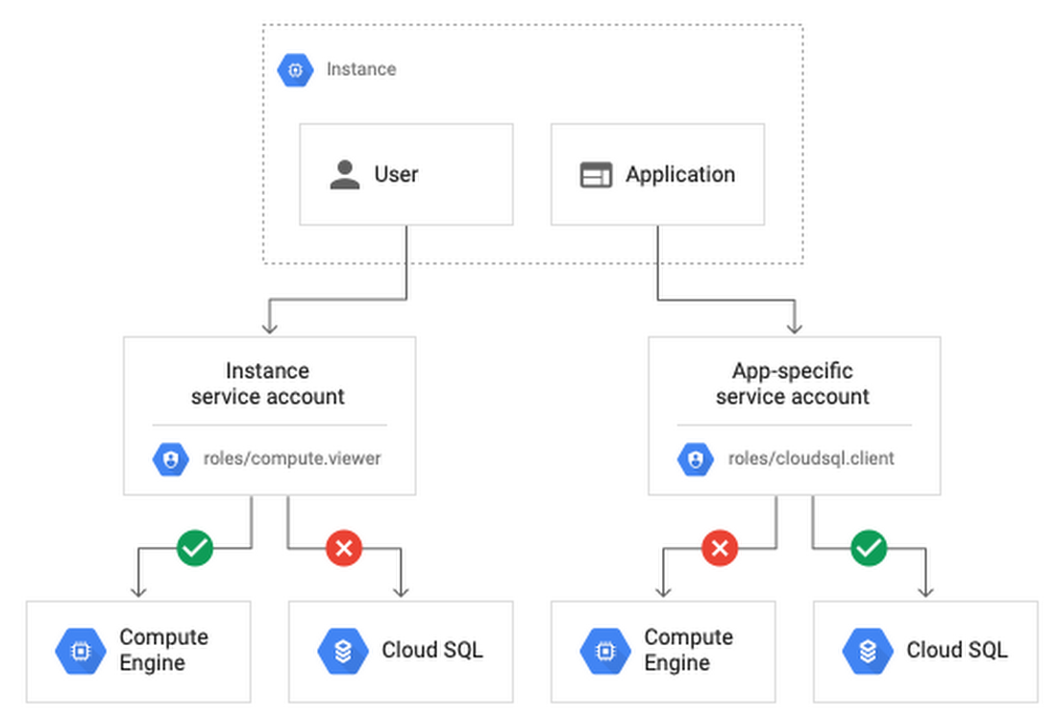
Least Privillage Illustration

Slide 14
Least Privillage Tools and Stratrgies
Groups : permissions are not applied on a user-by-user basis or application-by-application basis, but it’s given in the group of users
Multiple User Accounts for Administrators : ask the administrator to have two accounts, one role as user of the company’s applications systems and one for the role as an administrator
Account Standardization : standardize limitied number of account types to simplify complex environment

Slide 15
Least Privillage Tools and Stratrgies
Third-Party Applications : Third-party tools designed to make managing permissions easier. These can range from account lifecycle management applications to auditing applicatinos and applications firewalls
Processes and Procedures : Have a solid framework of processes and procedures for managing accounts. This framewotk allows company to rely on the defined process to determine how an account is created, classified, permissioned, and maintained

Slide 16
Least Privillage Benefits
Prevents the spread of malware
Decreases chances of a cyber attack
Improves user productivity
Helps demonstrate compliance
Helps with data classification

Slide 17
Separation of Duties

Slide 18
Understanding Separation of Duties
separation of duties is a principle that prevents any single person or entity from being able to have full access or complete all the functions of a critical or sensitive process
Seperation of Duties designed for :
Prevent fraud
Theft
And errors

Slide 19
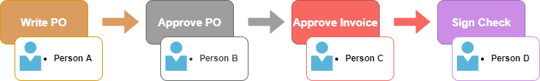
Separation of Duties Illustration

Slide 20
Understanding Separation of Duties
Example for Seperation of Duties :
In accounting, the Accounts Receivable employees review and validate bills, and the Accounts Payable employees pay the bills. In any case, those users involved with the critical processes do not have access to the logs. A third set of employees would review and validate what has been occurring and validate that there are no suspicious activities

Slide 21
Understanding an Attack Surface

Slide 22
Understanding an Attack Surface
An attack surface consists of the set of methods and avenues an attacker can use to enter a system and potentially cause damage.
The larger the attack surface of an environment, the greater the risk of a successful attack.
There are three types of attack surface : (1) Application attack surface, (2) Network attack surface, and (3) Employee attack surface

Slide 23
Types of Attack Surface
1. Application attack surface :
Number of data inputs to an application
Number of running services
Ports on which the application is listening
2. Network attack surface :
Overall network design
Placement of critical systems
Placement and rule sets on firewalls
3. Employee attack surface :
Risk of social engineering
Potential for humans errors
Risk of malicious behavior

Slide 24
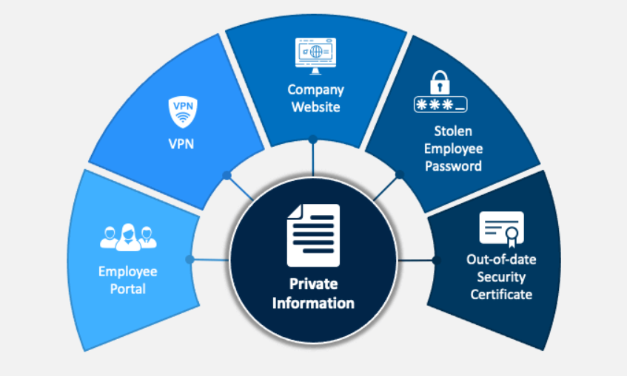
Attack Surface Illustration

Slide 25
Performing an Attack Surface Analysis
An attack surface analysis helps to identify the attack surface that an organization may be susceptible to
When analyzing a network, the first priority is to determine the security boundaries within an organization
After determining the security boundaries, the next step is to determine everything that connects at those security boundaries
With an understanding of the network infrastructure, the next step is to analyze the logs to see which traffic is allowed and which traffic is blocked.
When examining egress and ingress traffic, look at the source and target addresses as well as the ports used

Slide 26
Performing an Attack Surface Analysis
Testing can also be performed to identify open ports, services, and/or applications that are running on a system and what can be accessed from the outside
While analyzing traffic patterns, look at which traffic is encrypted and which traffic is not encrypted.
When a decision has been made to deploy or adopt a software solution or to build a software solution
Review current security policies to make sure that they are being followed
Review administrative accounts from time to time to ensure that proper access is provided to the right people
Update the list of attack surfaces as new vulnerabilities are discovered, as new systems are added, and as systems change

Slide 27
References
Text Book : Crystal Panek - Security Fundamentals-SYBEX_John Wiley & Sons (2020)
https://assets.website-files.com/5ff66329429d880392f6cba2/6230aa98a1120fbe9e9e47f0_CIA%20Triad.jpg
https://www.techtarget.com/searchsecurity/definition/principle-of-least-privilege-POLP
https://storage.googleapis.com/gweb-cloudblog-publish/images/custom_service_accounts.0526019805760391.max-1100x1100.png
https://cyberhoot.com/wp-content/uploads/2020/02/SoD-1-1.png
https://cdn.sketchbubble.com/pub/media/catalog/product/optimized1/3/4/34e9a3739b1db8f113c2de142d642e54b3fbec27cd6a44062fc12dba79acdc7f/attack-surface-slide1.png

